Slide 1
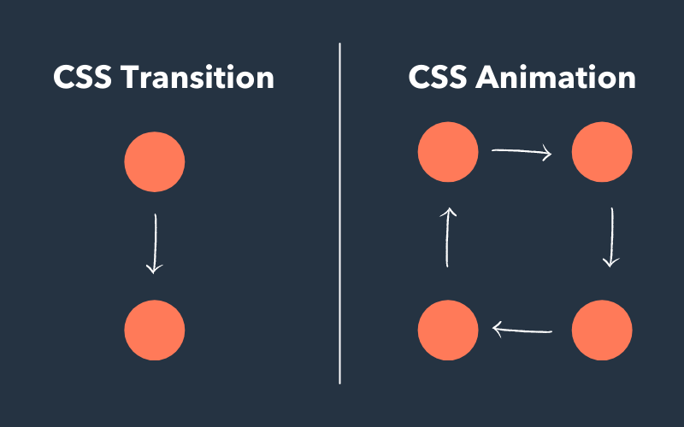
Transformace a Animace

Slide 2
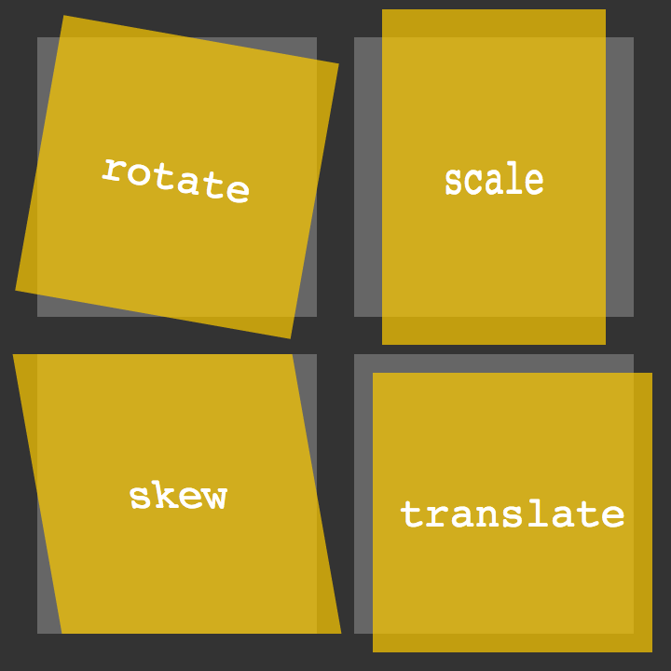
Transformace
translate()
rotate()
scaleX()
scaleY()
scale()
skewX()
skewY()
skew()
matrix()
Ukázky

Slide 3
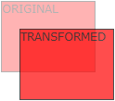
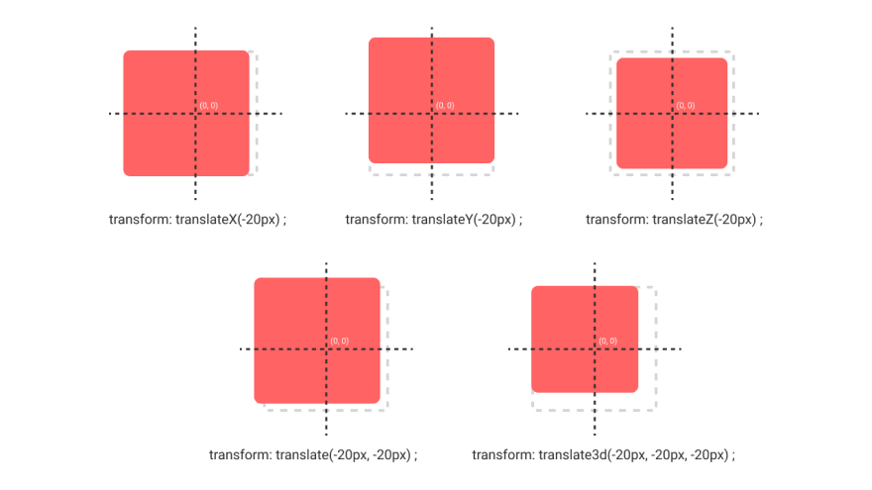
Translate()
transform: translate(50px, 100px);

Slide 4
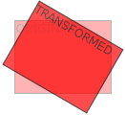
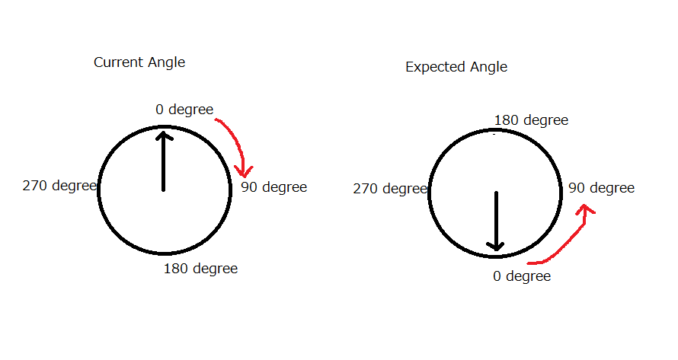
Rotate()
transform: rotate(20deg);
Rotace
Angle

Slide 5
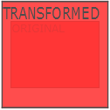
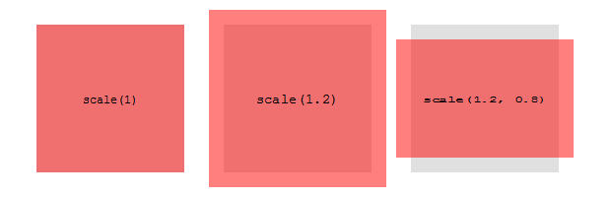
Scale()
transform: scale(2, 3);
transform: scaleX(2);
transform: scaleY(3);

Slide 6
Matrix()
transform: matrix(1, -0.3, 0, 1, 0, 0);
matrix(scaleX(), skewY(), skewX(), scaleY(), translateX(), translateY())

Slide 7
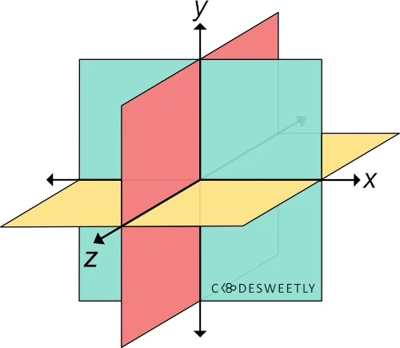
3D Transforms
rotateX()
rotateY()
rotateZ()

Slide 8
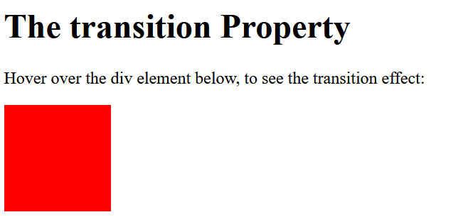

Transitions
Přechod mezi stavy (přesunem, otočením, změnou velikost)
div { width: 100px; height: 100px; background: red; transition: width 2s; }
div:hover { width: 300px; }

Slide 9
Transitions
Lze i nastavit pro více vlastností.
div { transition: width 2s, height 4s; }

Slide 10
Speed Curve of the Transition
#div1 {transition-timing-function: linear;}
ease - specifies a transition effect with a slow start, then fast, then end slowly (this is default)
linear - specifies a transition effect with the same speed from start to end
ease-in - specifies a transition effect with a slow start
ease-out - specifies a transition effect with a slow end
ease-in-out - specifies a transition effect with a slow start and end
cubic-bezier(n,n,n,n) - lets you define your own values in a cubic-bezier function
Ukázka

Slide 11
Další specifika
Prodlení:
transition-delay: 1s;
Celková specifikace:
div { transition-property: width; transition-duration: 2s; transition-timing-function: linear; transition-delay: 1s; }

Slide 12
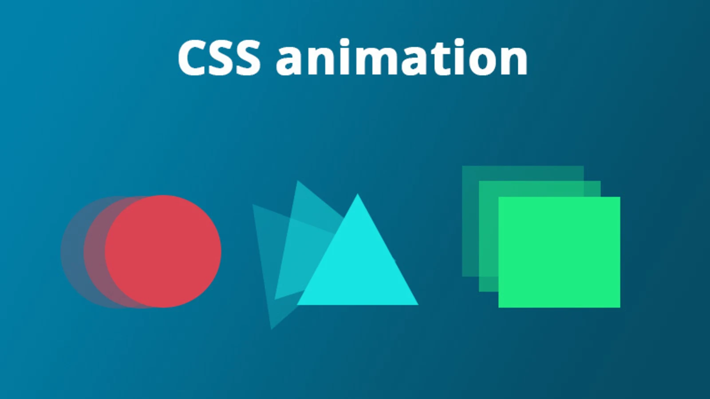
Animace
Animovat ze stavu A do stavu B
Možnost přechodu mezi více stavy
Příklady:
Stromek
Medúza
Hodiny
Další…

Slide 13
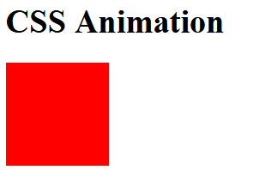
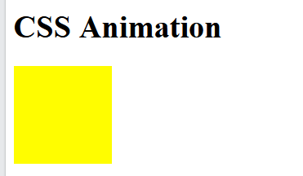
Animace
/* The animation code */
@keyframes example {
from {background-color: red;}
to {background-color: yellow;}
}
/* The element to apply the animation to */
div {
width: 100px;
height: 100px;
background-color: red;
animation-name: example;
animation-duration: 4s;
}

Slide 14
Animace – Více přechodů
div {
width: 100px;
height: 100px;
background-color: red;
animation-name: example;
animation-duration: 4s;
}
@keyframes example {
0% {background-color: red;}
25% {background-color: yellow;}
50% {background-color: blue;}
100% {background-color: green;}
}

Slide 15
Animace – Více vlastností
/* The animation code */ @keyframes example { 0% {background-color:red; left:0px; top:0px;} 25% {background-color:yellow; left:200px; top:0px;} 50% {background-color:blue; left:200px; top:200px;} 75% {background-color:green; left:0px; top:200px;} 100% {background-color:red; left:0px; top:0px;} } /* The element to apply the animation to */ div { width: 100px; height: 100px; position: relative; background-color: red; animation-name: example; animation-duration: 4s; }

Slide 16
Vlastnosti animací
Zpoždění
animation-delay: 2s;
Opakování
animation-iteration-count: 3;
animation-iteration-count: infinite;
Alternace (animation-direction)
normal - The animation is played as normal (forwards). This is default
reverse - The animation is played in reverse direction (backwards)
alternate - The animation is played forwards first, then backwards
alternate-reverse - The animation is played backwards first, then forwards

Slide 17
Rychlost animace
ease - Specifies an animation with a slow start, then fast, then end slowly (this is default)
linear - Specifies an animation with the same speed from start to end
ease-in - Specifies an animation with a slow start
ease-out - Specifies an animation with a slow end
ease-in-out - Specifies an animation with a slow start and end
cubic-bezier(n,n,n,n) - Lets you define your own values in a cubic-bezier function
Ukázka

Slide 18
animation-fill-mode
none - Default value. Animation will not apply any styles to the element before or after it is executing
forwards - The element will retain the style values that is set by the last keyframe (depends on animation-direction and animation-iteration-count)
backwards - The element will get the style values that is set by the first keyframe (depends on animation-direction), and retain this during the animation-delay period
both - The animation will follow the rules for both forwards and backwards, extending the animation properties in both directions

Slide 19
Shorthand Property
div { animation-name: example; animation-duration: 5s; animation-timing-function: linear; animation-delay: 2s; animation-iteration-count: infinite; animation-direction: alternate; }
Zkráceně:
animation: example 5s linear 2s infinite alternate;

